Slide 1


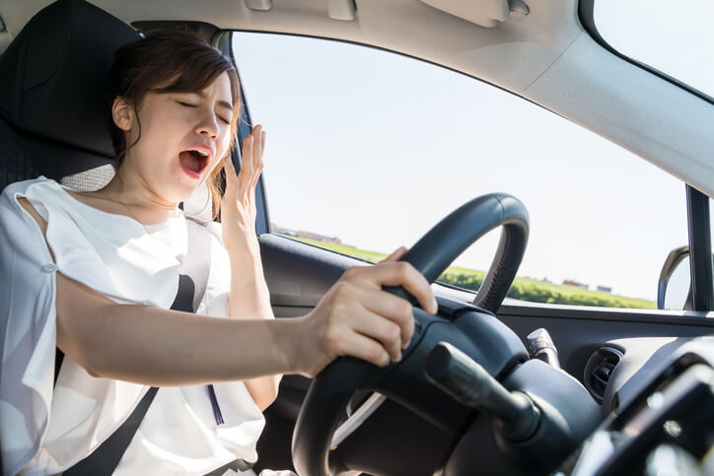
RAJ KUMAR GOEL INSTITUTE OF TECHNOLOGY GHAZIABAD
DEPARTMENT OF COMPUTER SCIENCE & ENGINEERING
SESSION:-2020-2021
DRIVER DROWSINESS DETECTION
SUBMITTED BY:-G-8
PRINCY UPADHYAY(1703310139)
LAUREN JAIN(1703310102)
SATYA MISHRA(1703310176)
SHRIYA GOYAL(1703310195)
GUIDE : DR. SACHI GUPTA(HOD CSE)

Slide 2
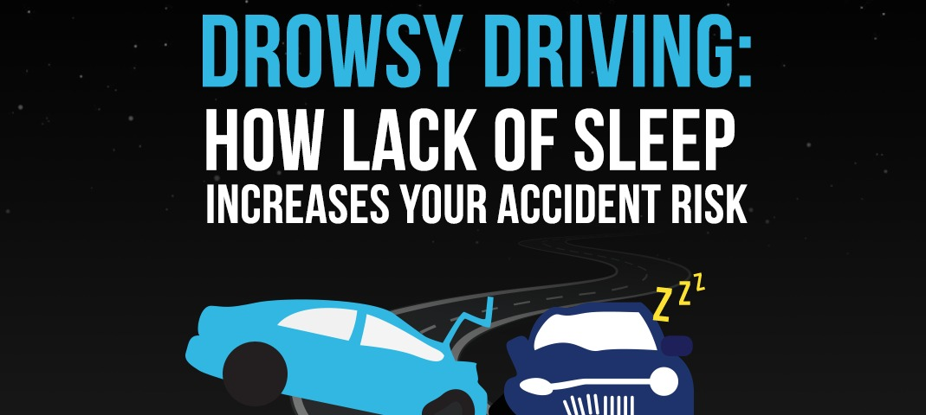
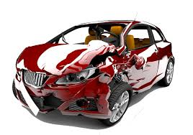
ABSTRACT
According to National Crime Records Bureau(NCRB) over 1,48,707 people were killed in road accidents.
Two wheelers account for 25% of total road crash deaths.
There is one death in every 4 minutes due to a road accident in India.
India ranks 1st in the number of road accidents.
According to NSF about 37% or 103 million people have fallen asleep at the wheel.

Slide 3
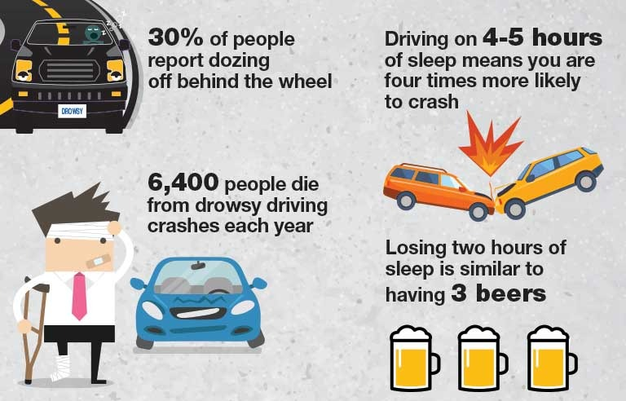
Introduction of the problem

Slide 4
LITERATURE SURVEY
Technique 1-Vehicle Based Measures:-These measurements are determined in a simulated environment by placing sensors on various vehicle components, such as the steering wheel and the acceleration pedal.[1]
Technique 2-Physiological Measures:-The correlation between physiological signals electrocardiogram (ECG), Electromyogram (EMG), Electrooculogram(EoG) and electroencephalogram (EEG)) and driver drowsiness has been studied by many researchers.[2]
Technique 3-Subjective Measures :-Subjective measures are those which evaluate the level of drowsiness based on the driver’s personal estimation.[3]
Technique 4-Behavioral Measures :-The behaviour of the driver, including yawning, eye closure, eye blinking, head pose, etc. is monitored through a camera and the driver gets alert if any of these drowsiness symptoms are detected.[4]

Slide 5
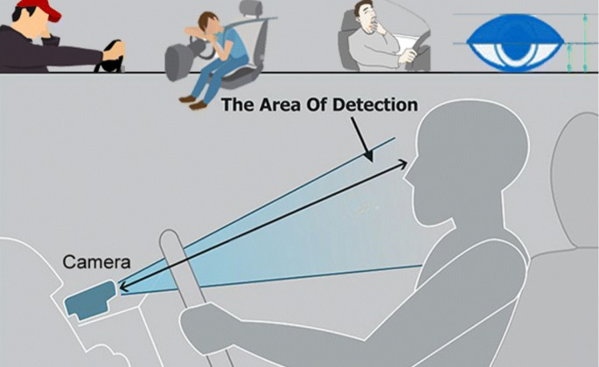
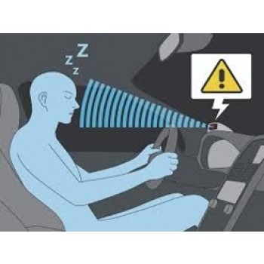
PROBLEM STATEMENT
Design a prototype of Driver Drowsiness Detection System using Computer vision.

Slide 6


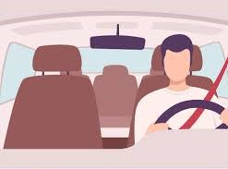
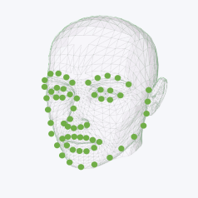

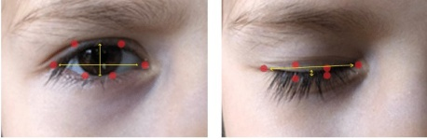
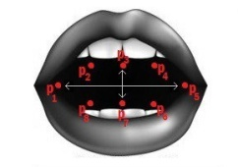
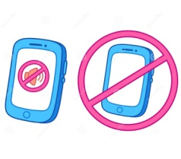

SOLUTION APPROACH / METHODOLOGY
System
Webcam
Video Capturing
Dividing Video into Frames
Send Location of Driver
Facial Landmarks Extraction
Near ones of Driver
Is it a drowsy state?
Eye Closure Detection
Yawn Detection
Yes
Alarm turnoff by Driver Manually
Warning Alarm
No

Slide 7
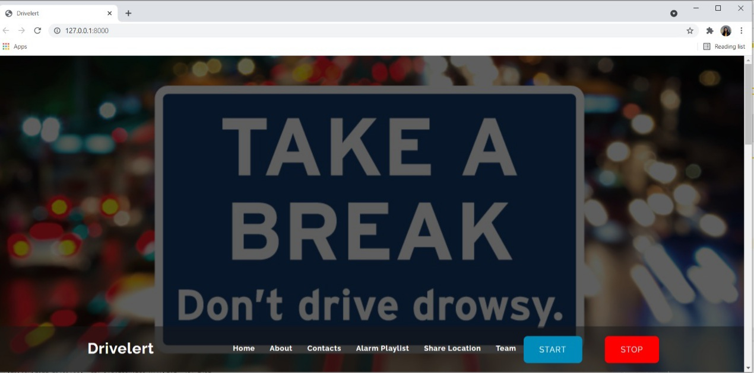
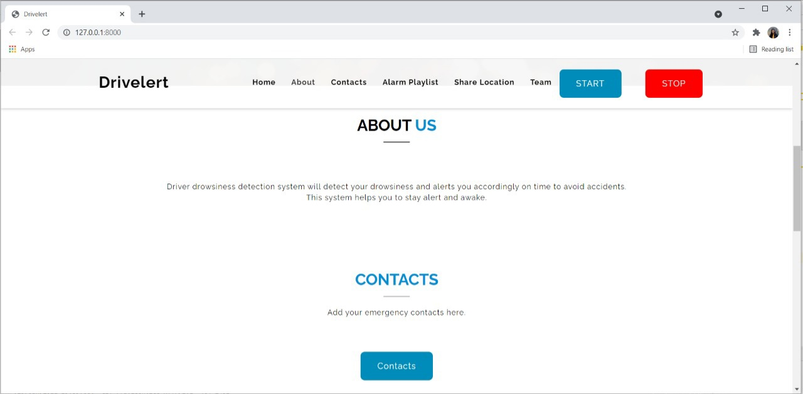
DESIGN
Starts counting frames per second
Stops Counting Frames

Slide 8
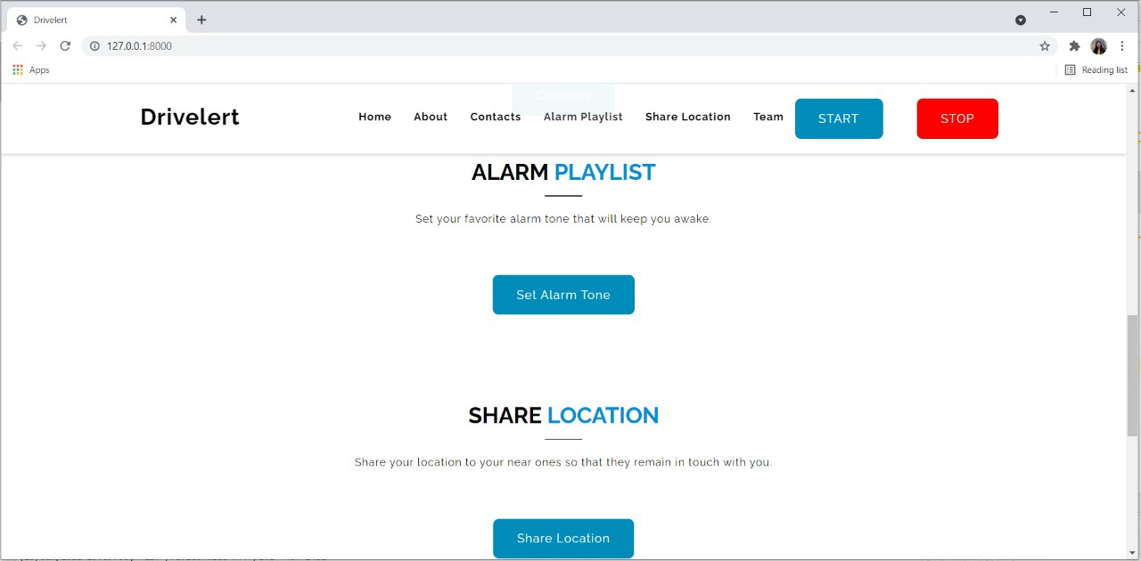
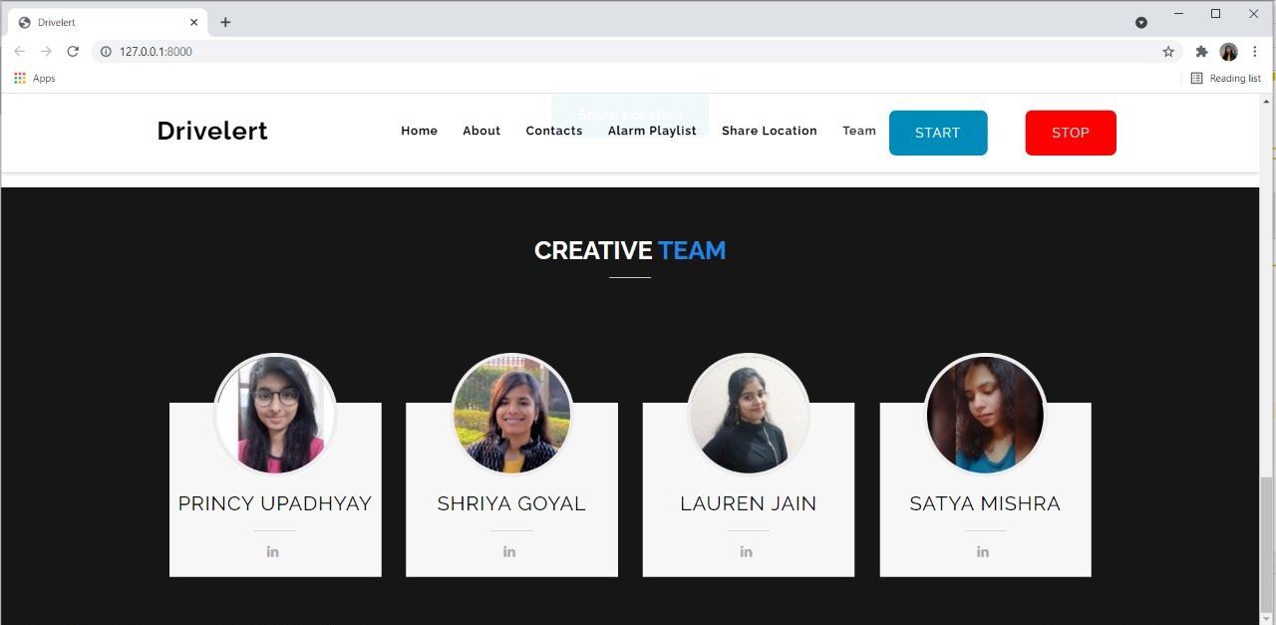
DESIGN

Slide 9
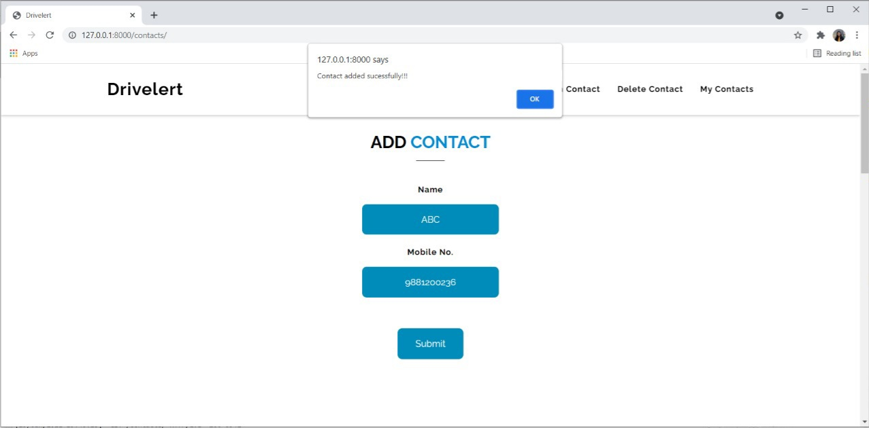
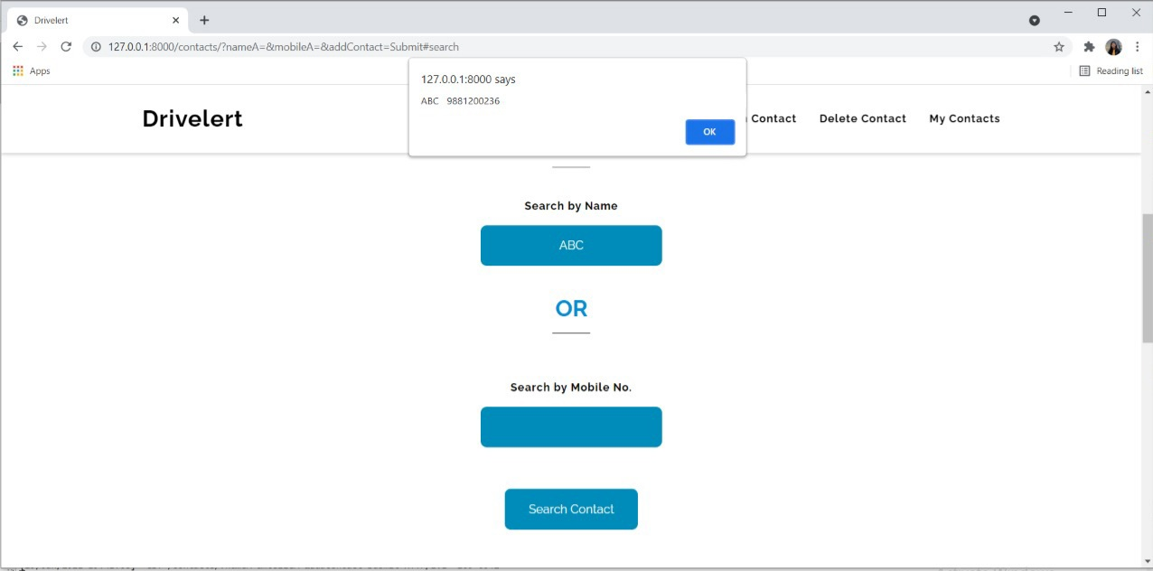
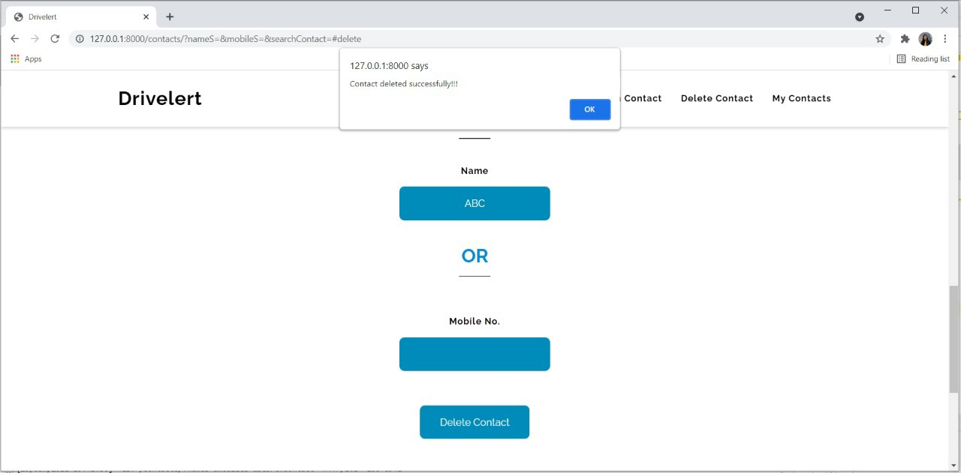
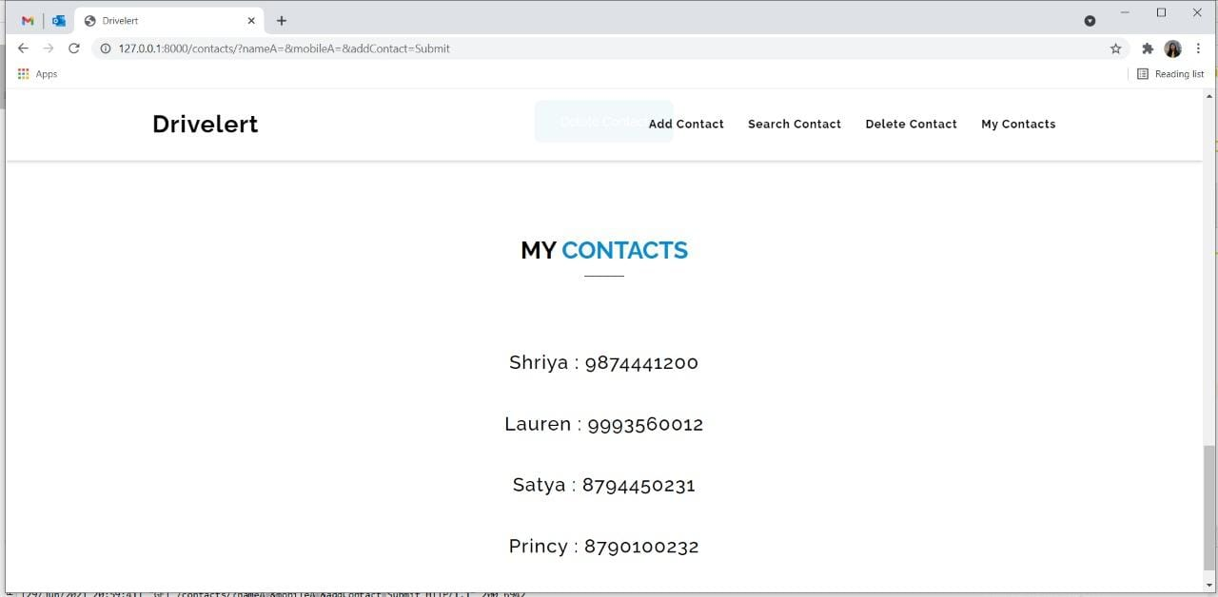
DESIGN

Slide 10
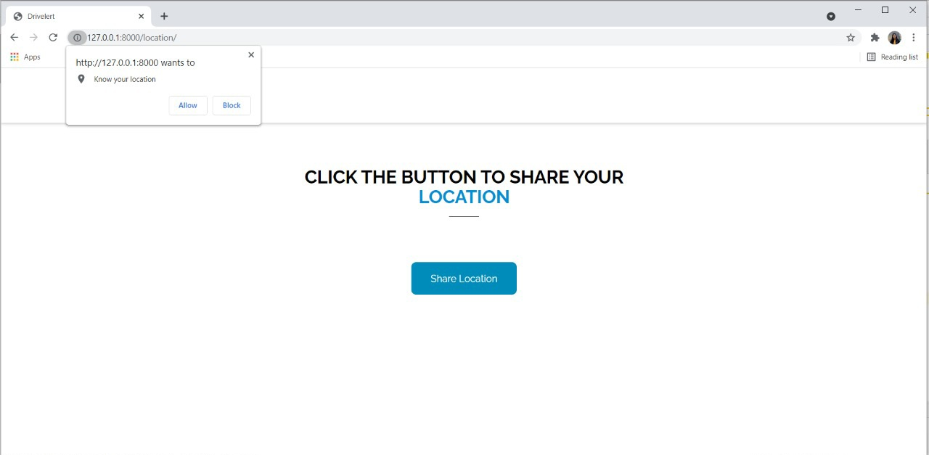
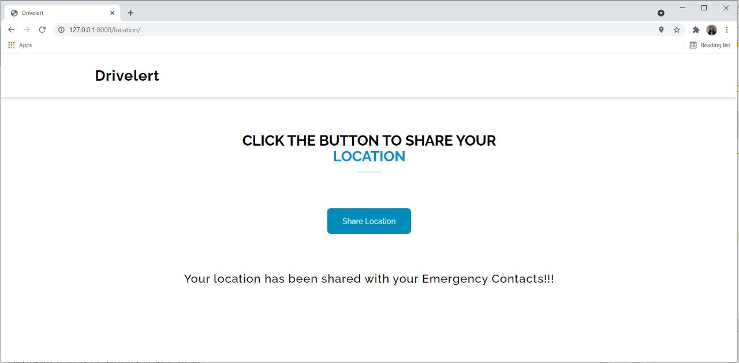
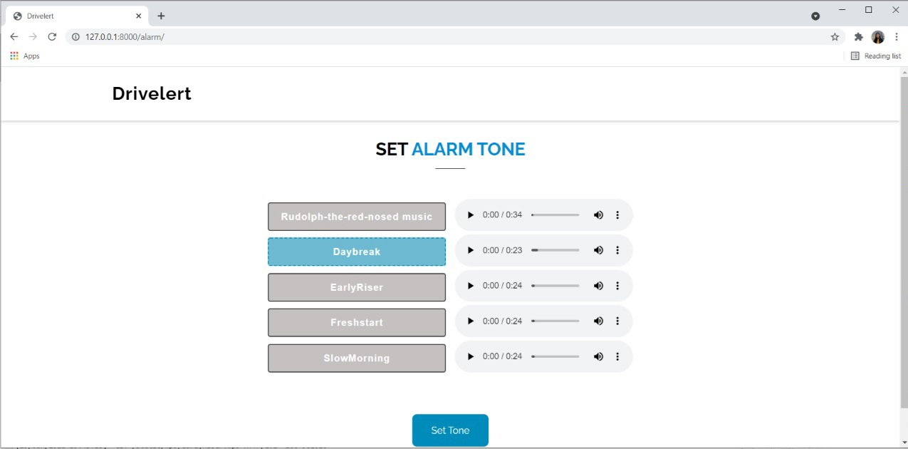
DESIGN

Slide 11
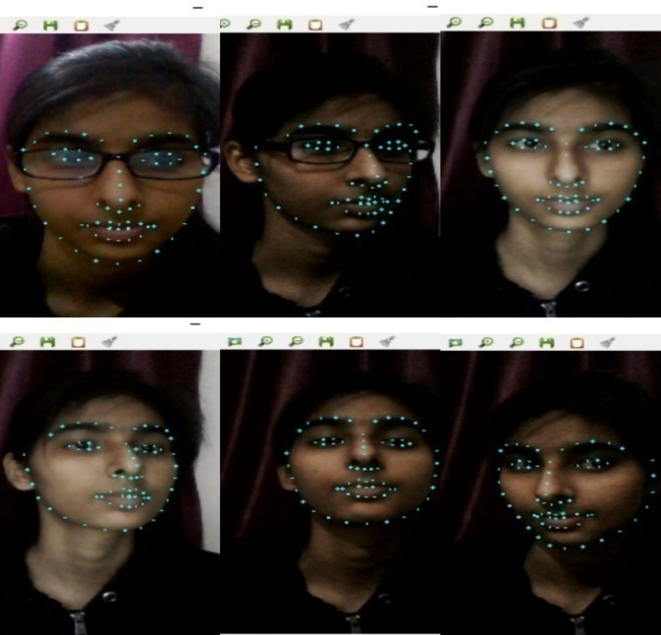
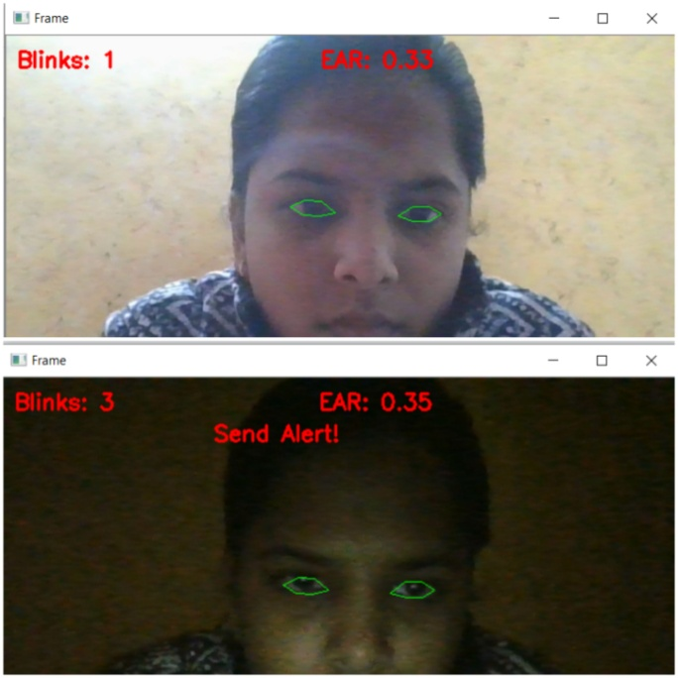
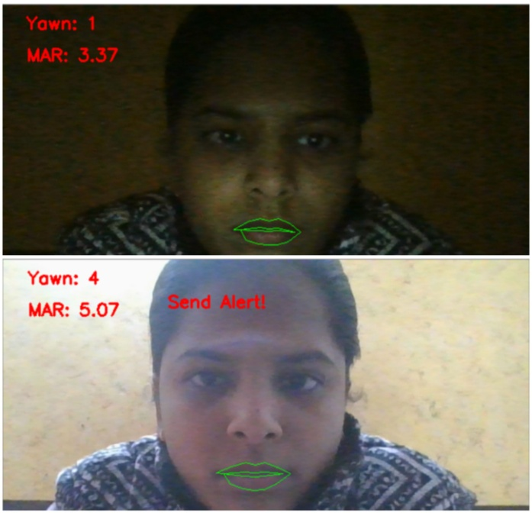
TESTING(TEST CASE)
The system is able to detect facial gestures at different angles also in dim light.

Slide 12
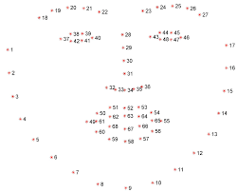
IMPLEMENTATION
Detection of facial landmark of driver in real time using OpenCV, dlib library.
The pre-trained facial landmark detector inside the dlib library is used to estimate the location of 68 (x, y)-coordinates that map to facial structures on the face.
Facial landmarks are used to localize and represent salient regions of the face, such as:
Eyes
Eyebrows
Nose
Mouth
Jawline
OUTPUT

Slide 13
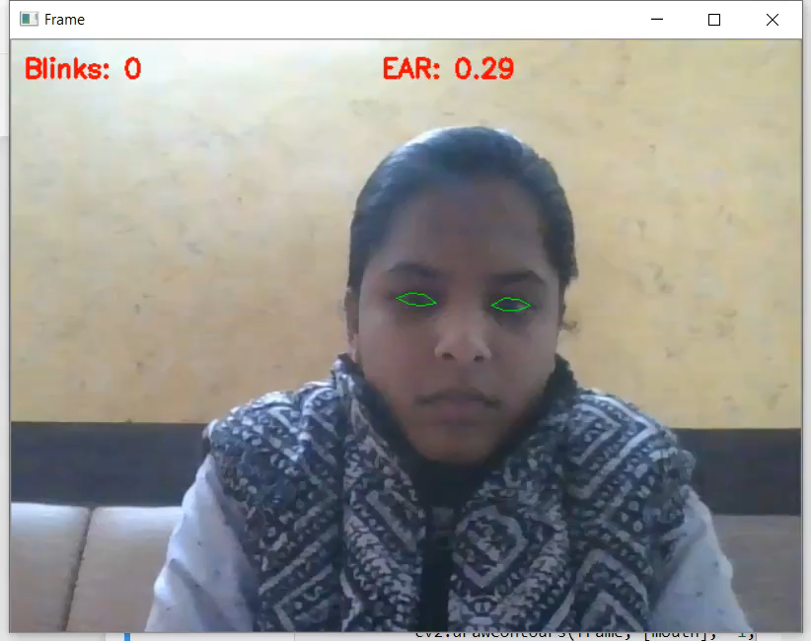
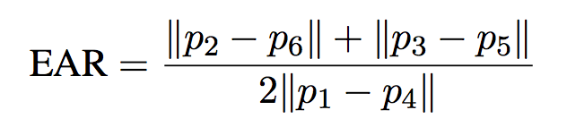
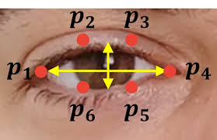
IMPLEMENTATION
Detection of eye blinking of the driver in real time using OpenCV and dlib.
Following are the steps for implementation of eye blinking :-
Eye localization.
Calculation of Eye Aspect Ratio.
Check condition
If EAR value is less than 0.30 in 30 frames then eye blink is detected and after 3 blinks, a warning is generated.
Or if EAR value is less than 0.30 in 90 frames then also a warning is generated.
OUTPUT

Slide 14
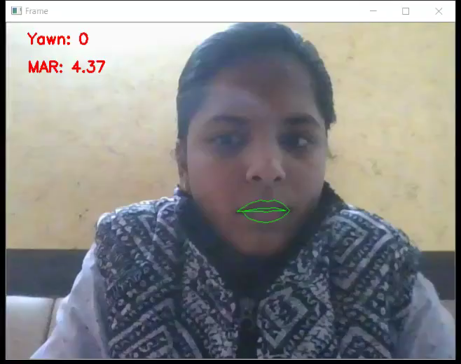
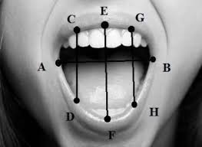
IMPLEMENTATION
Yawn Detection of driver in real time using OpenCV and dlib.
Following are the steps for implementation of yawn detection:-
Mouth localization.
Calculation of Mouth Aspect Ratio.
MAR=||C-D||+||E-F||+G-H||
3.0
Check condition
If MAR value is less than 14 in 30 frames then yawn detected.
If there are more than 2 blinks and 1 yawn then also the alert signal will be generated.
OUTPUT

Slide 15
FUTURE SCOPE
This project can be integrated with external camera in car, so that we can automatically detect driver's face.
Some more features can be added to this project to detect drowsiness like head position, shoulder position, etc. It will give more accuracy to drowsiness detection.

Slide 16
REFERENCES
[1]. JarekKrajewski, David Sommer, UdoTrutschel, Dave Edwards, Martin Golz. Steering Wheel Behavior Based Estimation of Fatigue. June,2009;
https://ir.uiowa.edu/cgi/viewcontent.cgi?article=1311&context=drivingassess ment
[2]. Zahra Mardi, Seyedeh Naghmeh Miri Ashtiani, Mohammad Mikaili. EEG- based Drowsiness Detection for Safe Driving Using Chaotic Features and Statistical Tests, Zahra Mardi. May-Aug, 2011; https://www.ncbi.nlm.nih.gov/pmc/articles/PMC3342623/
[3]. Alina Mashko. Subjective Methods For Assessment Of Driver Drowsiness. December, 2017.
https://www.researchgate.net/publication/322205318_SUBJECTIVE_METHO DS_FOR_ASSESSMENT_OF_DRIVER_DROWSINESS
[4]. SayaniGhosh, T. Nandy, Nilotpal Manna. Real Time Eye Detection and Tracking Method for Driver Assistance System. 2015; https://www.semanticscholar.org/paper/Real-Time-Eye-Detection-and-Tracking-MethodforGhoshNandy/6d4407b102766cef693c873f4ce37bb19b58bb8c

Slide 17
THANK YOU

